Slide 1
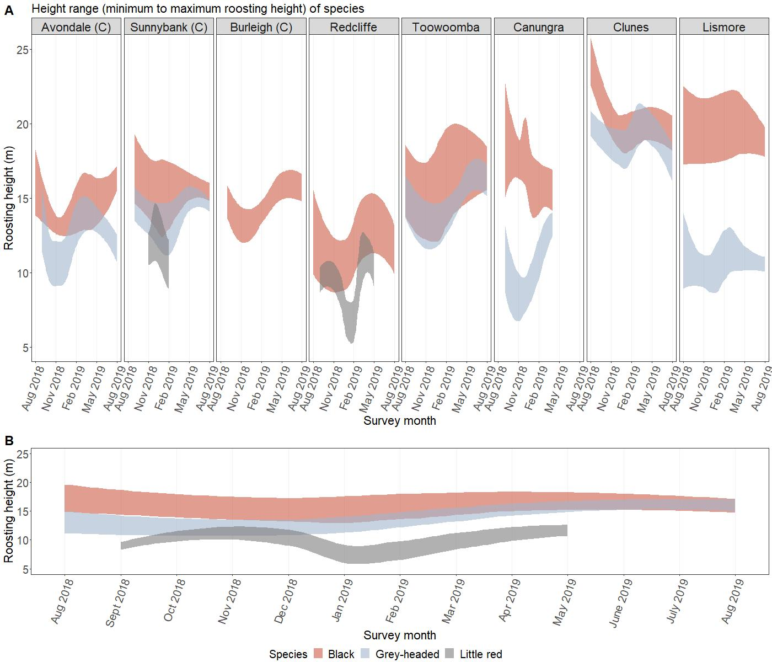

Slide 2
site.code species mean_canopy
1 DAVO all 12.733333
2 DBUR all 17.080000
3 DCAN all 9.676852
4 DCLU BFF 22.166667
5 DCLU GHFF 20.637500
6 DLIS BFF 13.350000
7 DLIS GHFF 10.850000
8 DRED all 8.874074
9 DSUN all 14.234333
10 DTOW all 16.145185

